Slide 1
Python 101
Lecture 4

Slide 2
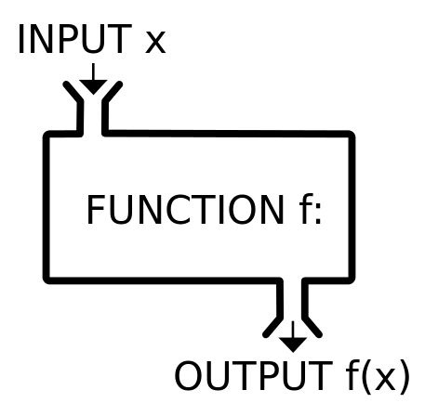
Functions
Responsible from a specific and probably monotonous job.
Help us to get rid of redundancy.
Provide reusable & maintainable code.
May or may not have inputs (parameters or arguments) and outputs (return values).
def get_speed(distance, time):
return(distance/time)
PEP 8 Naming Conventions

Slide 3
No parameter + No return def print_random_area():
print(3.14*(random.randint(5,20)**2))
Parameter + No return def print_area(radius):
print(3.14*(radius**2))
Default Parameter + No return def print_area(radius = 10): print(3.14*(radius**2))
Parameter + Return def get_area(radius): return 3.14*(radius**2)
No parameter + Return def get_random_area(): return 3.14*(random.randint(5,20)**2)

Slide 4
Function Call
def print_area(r):
print(3.14*r*r)
def cube(x):
return x*x*x
def main():
print_area(10)
print(cube(3))
main()
How many function calls in here?

Slide 5
Function Call
def print_area(r):
print(3.14*r*r) # Function call 3
def cube(x):
return x*x*x
def main():
print_area(10) # Function call 2
print(cube(3)) # Function call 4 and 5
main() # Function call 1
“print” is a built-in function.

Slide 6
Exercises

Slide 7

Sum of a list with function
Define a function that takes a list as a parameter and returns the result of the following operation.
In main program, print the result of the operation using the list below.
a_list = [12, -7, 5, -89.4, 3, 27, 56, 57.3]

Slide 8
Prime Numbers
Define following functions:
a function that decides whether given integer is a prime number or not: is_prime
a function that prints the prime numbers between given two integers: print_primes_between
In main program, ask user for two integers, then print prime numbers between them.

Slide 9
List Overlap
Define following functions:
A function that generates a list of random integers in [b, e] with length of N: get_rand_list
A function that takes two lists and returns the intersection of them: get_overlap
In main program,
Define two randomly generated lists for b=0, e=10, N=5.
Print both lists and their overlap.
You have to include the following lines of code at the beginning of your program:
import random
random.seed(12)
Use random.sample(range(b,e),N) for creating the list

Slide 10
Binary to Decimal
Define following functions:
A function that gets a binary number and converts it to decimal: binary_to_dec
A function that gets a decimal number and converts it to binary: dec_to_binary
In main program, call each function for “10010” and 18 respectively.
Hint: Keep binary numbers as string.

Slide 11
File Processing
Opens the given file and returns a file object
file_object = open("filename")
Example:
f = open("bankaccount.txt")

Slide 12
File Processing
Sr.No. | Modes & Description
1 | r Opens a file for reading only. The file pointer is placed at the beginning of the file. This is the default mode.
2 | rb Opens a file for reading only in binary format. The file pointer is placed at the beginning of the file. This is the default mode.
3 | r+ Opens a file for both reading and writing. The file pointer placed at the beginning of the file.
4 | rb+ Opens a file for both reading and writing in binary format. The file pointer placed at the beginning of the file.
5 | w Opens a file for writing only. Overwrites the file if the file exists. If the file does not exist, creates a new file for writing.
6 | wb Opens a file for writing only in binary format. Overwrites the file if the file exists. If the file does not exist, creates a new file for writing.
7 | w+ Opens a file for both writing and reading. Overwrites the existing file if the file exists. If the file does not exist, creates a new file for reading and writing.
8 | wb+ Opens a file for both writing and reading in binary format. Overwrites the existing file if the file exists. If the file does not exist, creates a new file for reading and writing.
9 | a Opens a file for appending. The file pointer is at the end of the file if the file exists. That is, the file is in the append mode. If the file does not exist, it creates a new file for writing.
10 | ab Opens a file for appending in binary format. The file pointer is at the end of the file if the file exists. That is, the file is in the append mode. If the file does not exist, it creates a new file for writing.
11 | a+ Opens a file for both appending and reading. The file pointer is at the end of the file if the file exists. The file opens in the append mode. If the file does not exist, it creates a new file for reading and writing.
12 | ab+ Opens a file for both appending and reading in binary format. The file pointer is at the end of the file if the file exists. The file opens in the append mode. If the file does not exist, it creates a new file for reading and writing.

Slide 13
Reading Files
Built-in functions to read files
f.read() -> file's entire contents as a string
f.readline() -> next line from file as a string
f.readlines()-> file's contents as a list of lines

Slide 14
Line by line processing
Reading a file line-by-line using a for loop:
for line in f.readlines():
statements
Example:
f = open("bankaccount.txt")
count = 0
for line in f.readlines():
count = count + 1
print("The file contains", count, "lines.")
Notes:
The lines from a file object can also be read using a for loop

Slide 15
Writing Files
open file for write (deletes previous contents), or open file for append (new data goes after previous data)
f = open("filename", "w")
f = open("filename", "a")
Writing the given string to the file:
f.write(str) -> Returns the number of characters written.
Closing the file
f.close() - saves file once writing is done
>>> out = open("output.txt", "w")
>>> out.write("Hello, world!\n")
>>> out.write("How are you?")
>>> out.close()
>>> open("output.txt").read()

Slide 16
Exercises

Slide 17
File Writing
Ask user for name, salary, and department of an employee. Append this employee with a unique ID to the given file. Repeat this process until user enters 0 for name.
First: Try to append:
12,Ali,4000,Management\n

Slide 18
File Reading
Ask user for department and print the name of the person who has the highest salary in that department.
Given file is named Employees.csv . All the lines consist of comma-separated values ID,Name,Salary,Department.
Sample content:
1,King,5000,Management
2,Blake,2850,Management
3,Martin,2465,Sales
4,Ward,3000,Human resources

